Slide 1
Selenium Course Session 1
Instructor: Shihabul Khandakar
Resource(s): http://autotechnotes.weebly.com/

Slide 2
What is Selenium?
Selenium is a set of tools and libraries that automates web browser actions.
Actions like - click, input, select, navigate etc.
Selenium is not a tool but a library of tools
Selenium is free and Open Source

Slide 3
Features of Selenium
Multiple Languages supported
Multiple Browsers supported
Multiple Operating System supported
Supports Web Application only
Flexible and Extensible

Slide 4
Selenium Supports
Languages
Java
C#/.Net
Python
Ruby
JavaScript
Browser
Chrome
Firefox
Internet Explorer
Safari
Edge etc.
Operating System
Windows
Mac OS
Linux
Solaris

Slide 5
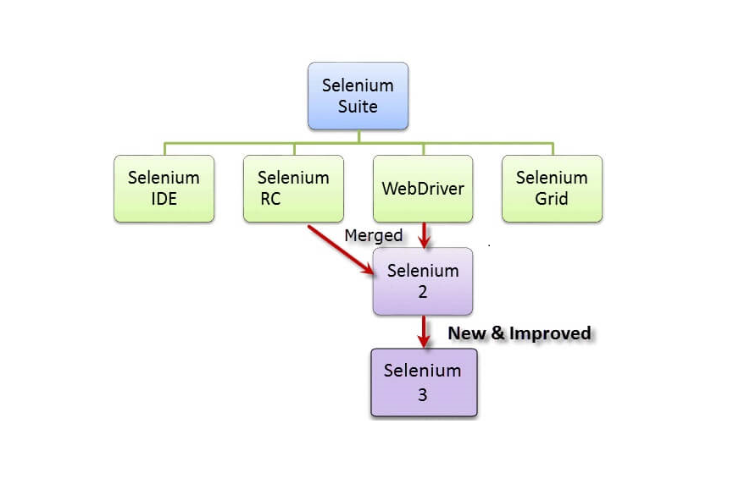
Types or Components of Selenium
Selenium Integrated Development
Environment (IDE)
Selenium Remote Control (RC)
WebDriver
Selenium Grid

Slide 6
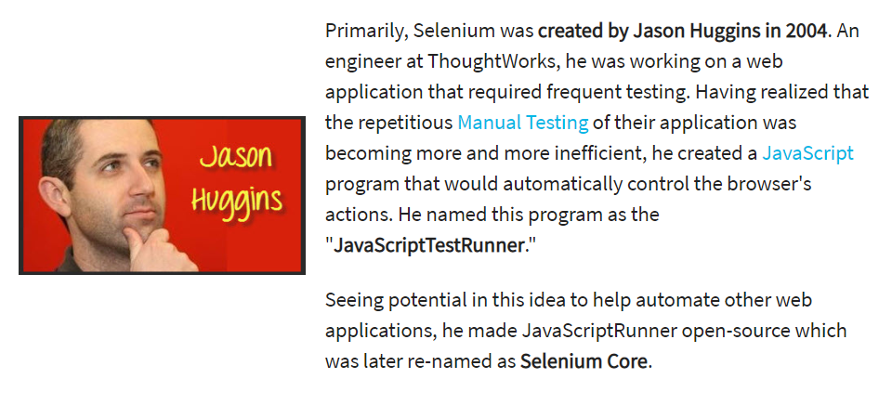
Who Developed Selenium?

Slide 7
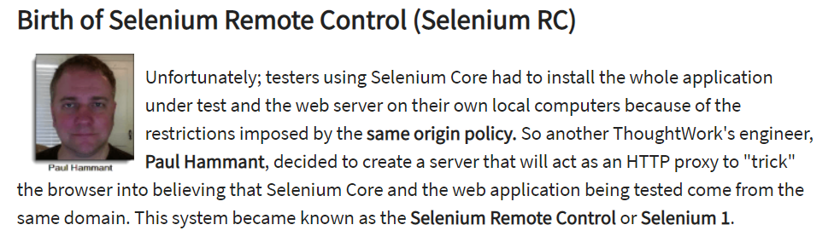
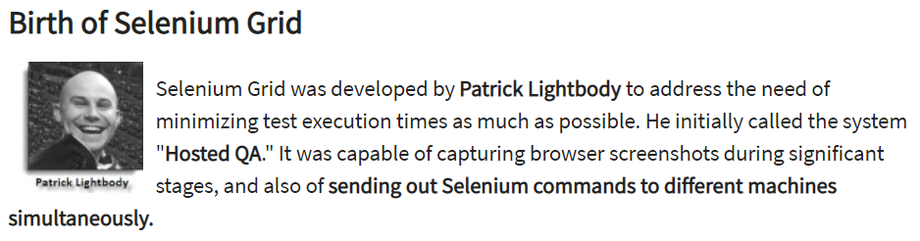

Slide 8
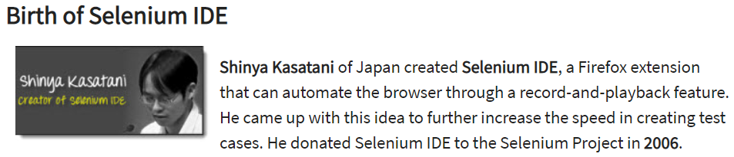
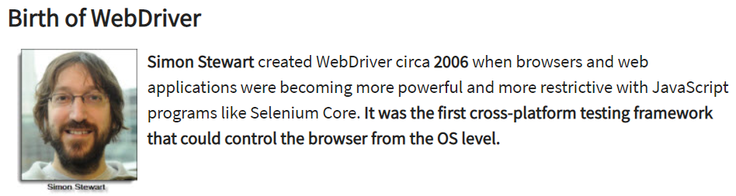

Slide 9
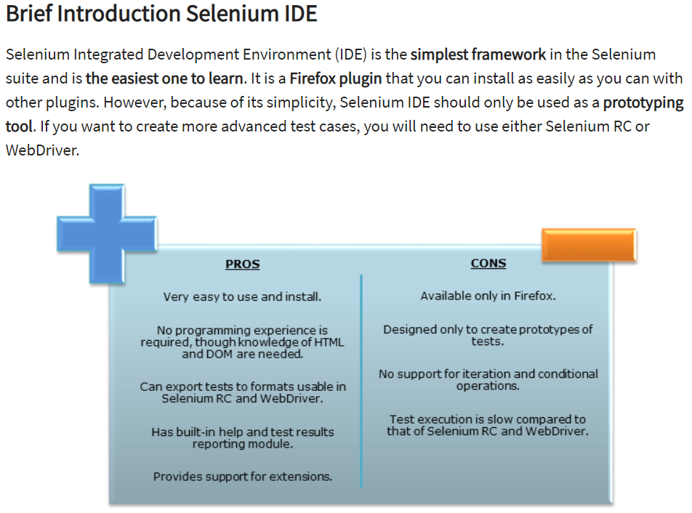

Slide 10
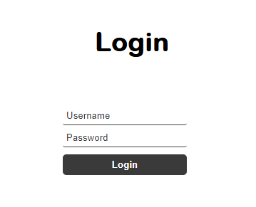
How it works..
1
Identify web elements
(by using identifiers)
2
Add Actions
(by using preferred programming language)
Input
Test
Data
Click
3
Run the test

Slide 11
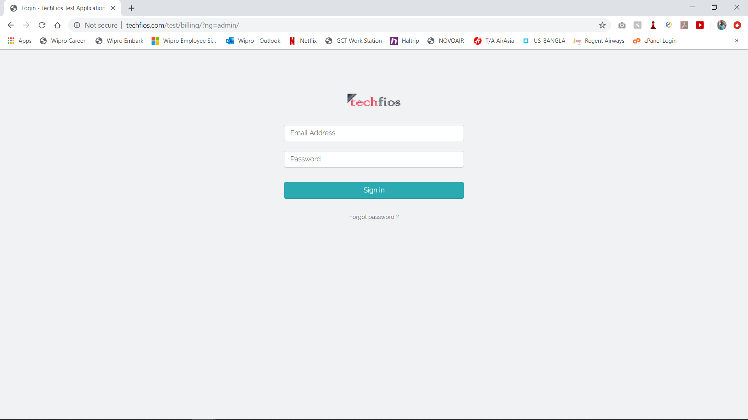
Techfios Testing Website
Web Link: http://www.techfios.com/billing/?ng=admin/
User Name: demo@techfios.com
Pass Word: abc123

Slide 12
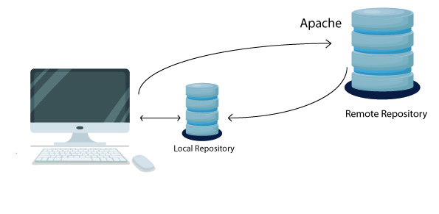
What is Maven?
Maven is a project management and comprehension tool that provides developers a complete build lifecycle framework.
It is used to build and manage primarily Java projects. But also can be used with languages.
Maven Dependency:
Dependency is an archive of JAR, which
current project needs to compile, build
and run. Dependencies are gathered in
the POM.
Link: https://mvnrepository.com/

Slide 13
Maven Lifecycle
validate - validate the project is correct and all necessary information is available
compile - compile the source code of the project
test - test the compiled source code using a suitable unit testing framework. These tests should not require the code be packaged or deployed
package - take the compiled code and package it in its distributable format, such as a JAR.
verify - run any checks on results of integration tests to ensure quality criteria are met
install - install the package into the local repository, for use as a dependency in other projects locally
deploy - done in the build environment, copies the final package to the remote repository for sharing with other developers and projects.

Slide 14
.xml Structure
Opening Tag
<properties>
<project.build.sourceEncoding>UTF-8</project.build.sourceEncoding>
</properties>
<dependencies>
<dependency>
<groupId>junit</groupId>
<artifactId>junit</artifactId>
<version>3.8.1</version>
<scope>test</scope>
</dependency>
</dependencies>
Closing Tag
Opening Tag Structure
< >
Closing Tag Structure
</ >
Opening Tag
Closing Tag

Slide 15
Demo Test Cases
TC No | TC Name | Test Steps | Expected Result | Actual Result | Pass/Fail
2004-1 | Login Test | Open Chrome | Chrome should Open | Chrome opened
 |  | Go to Techfios Website | Should be able to go to Website | Website displayed
 |  | Provide Username | User name should typed in the box | Username typed
 |  | Provide Password | Password should typed in the box | Password typed
 |  | Click in the Sign In button | Sign In button should be clicked | Sign In button clicked
 |  | Display Home page | Home page should display | Home page Displayed

Slide 16
What is JUnit..
JUnit is a unit testing framework for Java programming language.
@Test :
It is called Annotation
This annotation tells JUnit to run the public void method to which it is attached.
Annotations:
@BeforeClass – Run once before any of the test methods in the class
@Before – Run before @Test
@Test – This is the test method to run
@After – Run after @Test
@AfterClass – Run once after all the tests in the class have been run

